Slide 1
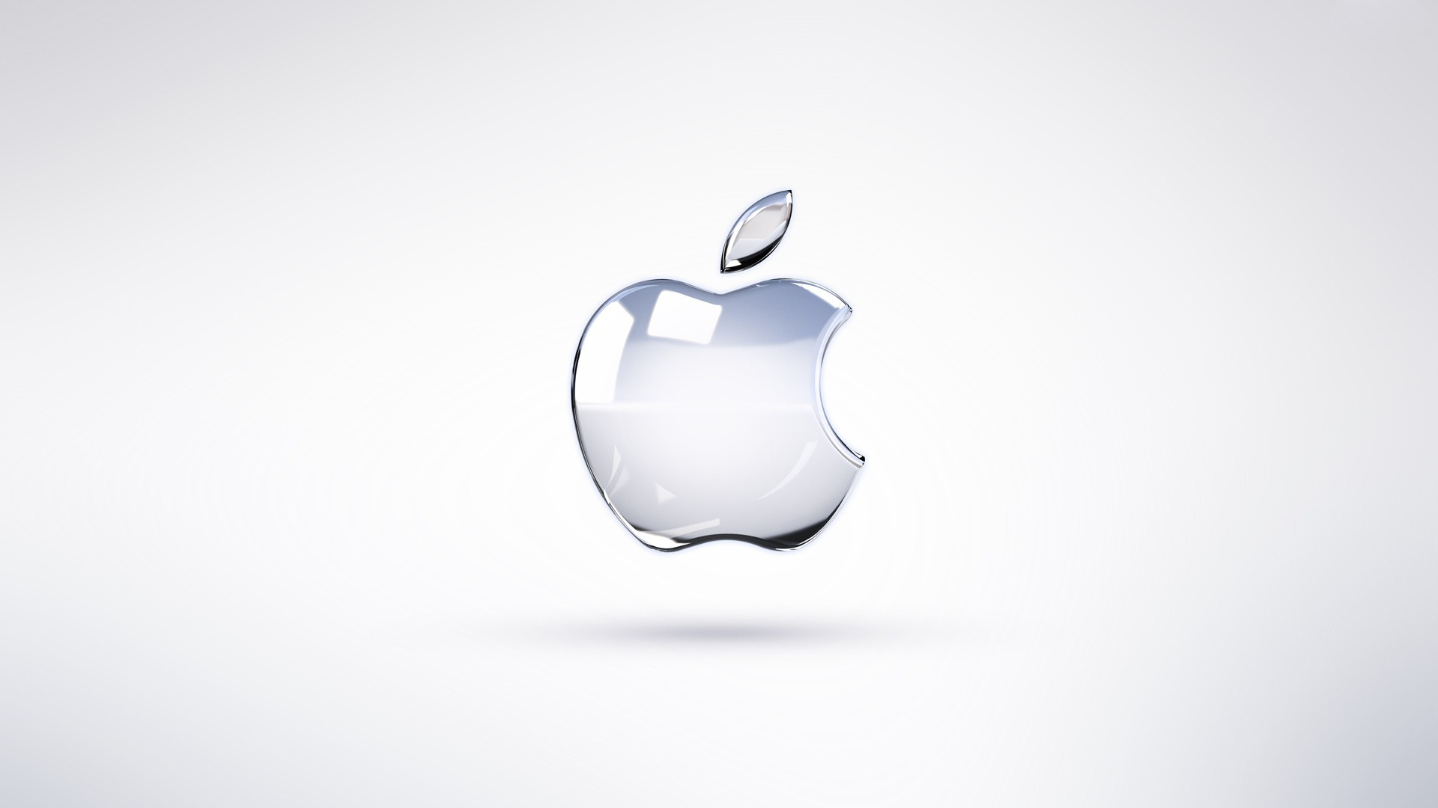
Mac’s
Training for when your used to PC’s with Windows

Slide 2
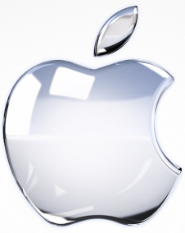
Different Operating Systems Same Stuff
PC’s use Windows for their operating system (most of the time).
Mac’s use OSX for their operating system (most of the time).
Both of these have very similar features they are just called different things and located in different places…now were going to do some matching up.

Slide 3
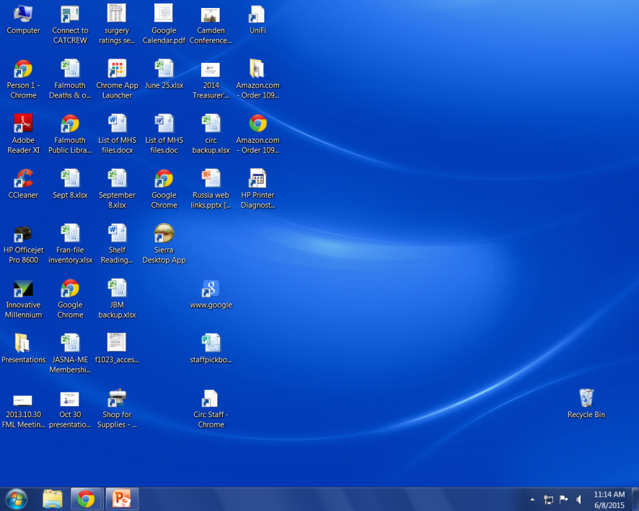
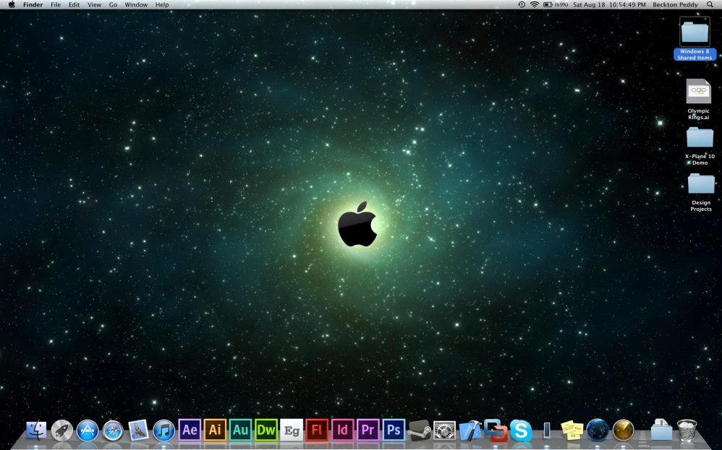
Windows PC Desktop | Mac Desktop
Program & File icons, Clock, large open space for more stuff…side by side they look pretty similar don’t they.
For a bit of history this is because they both copied the idea for this kind of graphic interface from Xerox a long time ago.

Slide 4
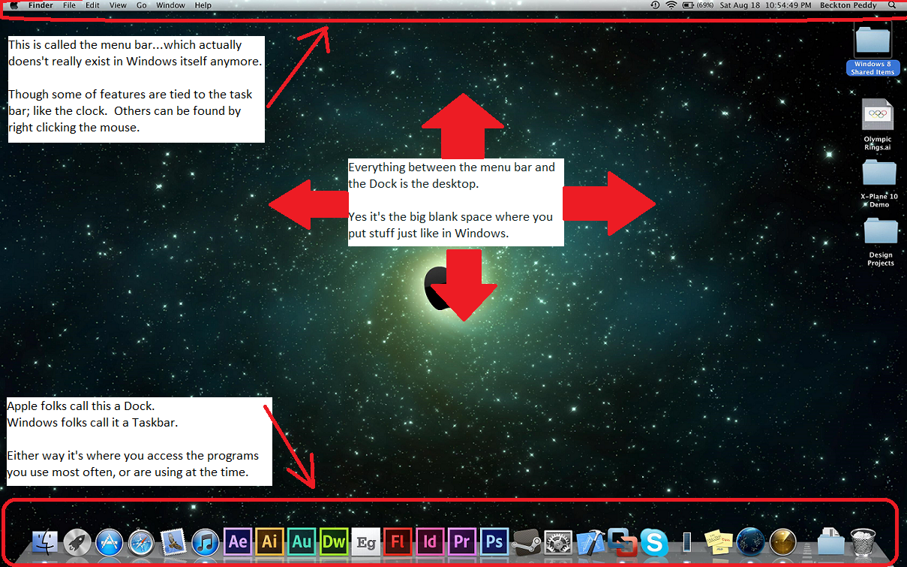
Now for the Similarities & Differences

Slide 5
Start vs. Finder
The start button and finder a pretty similar.
Both show you all the programs on your computer.
Both allow you to search for a file.
Both give you access to the various directories on your computer via shortcut icons / links. (Documents, Pictures, Music, etc…)

Slide 6
More of the Same
Both Windows and OSX have a recycle bin / trash can.
In both you can click and drag stuff into the recycle bin, or into any folder you want.

Slide 7
Making Windows Bigger, Smaller, or Go to the Taskbar / Dock
This ones a bit backward for most windows users.
The buttons for this are on the top left instead of top right.
The X (as in windows) closes the window.
The --- as in windows minimizes the window to the Dock.
And the + is equal to the Square icon in windows that maximizes the window to full screen.

Slide 8
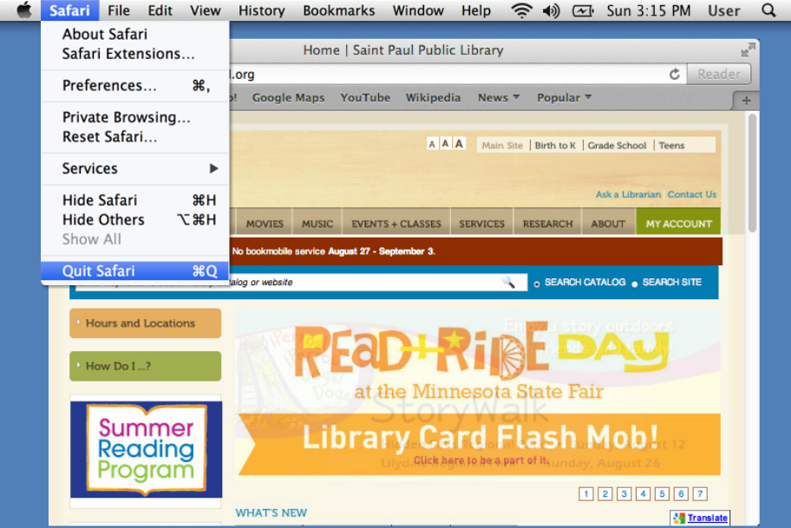
The Menu Bar
An important thing to note about the menu bar is that the options change depending on which program you are running.
The exception to this is the little apple Icon which is always there.

Slide 9
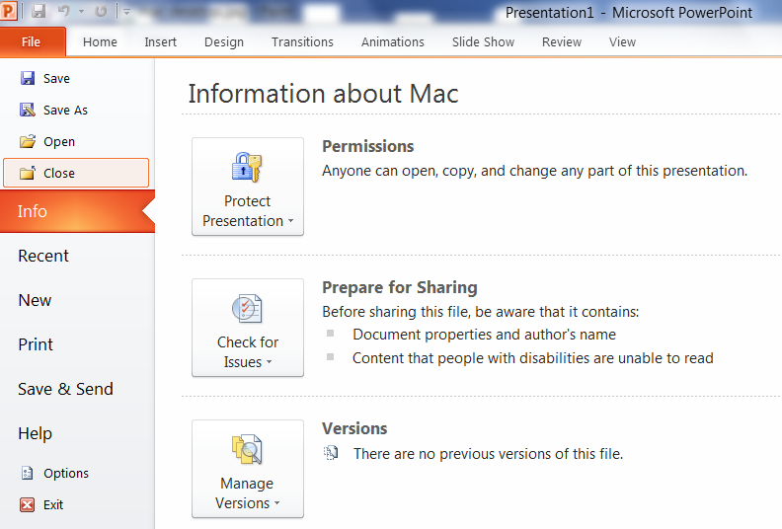
Windows Menu / Toolbars / Ribbons
Windows has changed the name of the menu bar over the years. From Menu bar, to Toolbar, now to Ribbons.
When you are in a program it does the same things as the Mac Menu Bar.
Windows just doesn’t keep it up on the desktop at all times.

Slide 10
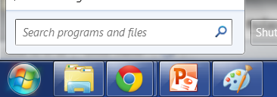
Spotlight = Search
If the fact that both features use a magnifying glass wasn’t clue enough the Mac Spotlight feature lets you search your computer for anything … just like the Windows Search feature.

Slide 11
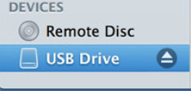
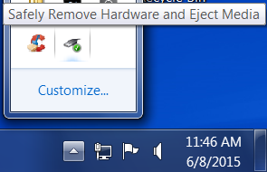
Ejecting USB’s Safely
Mac OSX gives you a nice little “eject” icon next to the drive when you are in Finder, Or you can right click the drive icon (which shows up on the desktop) and click the icon there.
Windows hides the option under the little up arrow on the task bar. The little USB plug with a green check lets you eject USB drives safely.
Again both OS’s give the option to eject a USB drive (Thumb Drive) safely, but they are in different places.

Slide 12
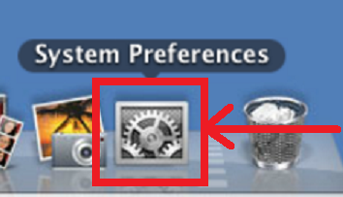
Changing Settings…bit of techie stuff.
The Mac’s System Preferences icon gives access to the same tools as the Control Panel has in Windows.
For those who like to tweak their system a bit, or even just want to change the background / screensaver the System Preferences or Control Panel get you to the tools where you can do that.
Also good to know if you want to fix a computer yourself.

Slide 13
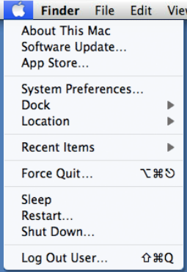
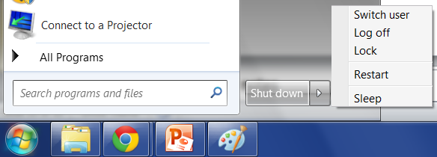
I Just Want to Turn This Thing Off!
Remember that never changing Apple icon…well that’s where Mac OSX hid the shutdown options.
Windows hid them under the Start, Shutdown menu.
Sadly both Windows and Mac’s have taken to button the shutdown options a few clicks away.

Slide 14
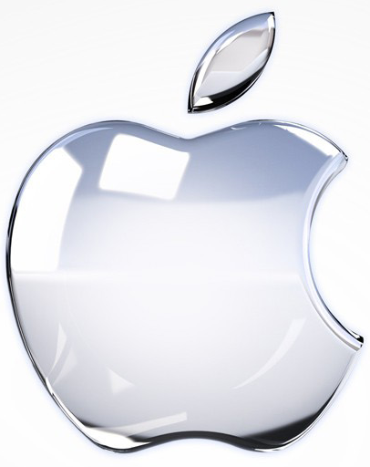
Any Questions?

